Slide 1
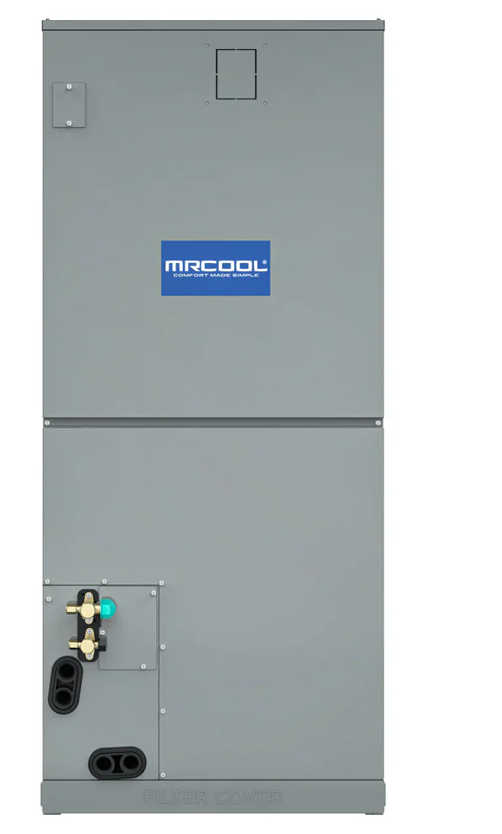
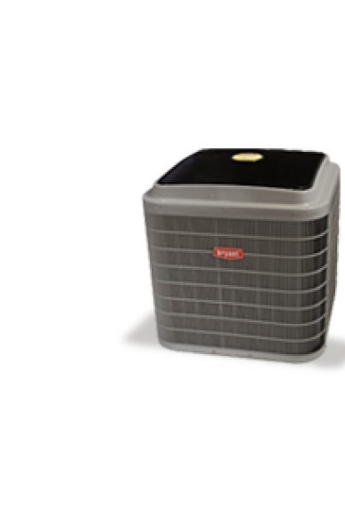
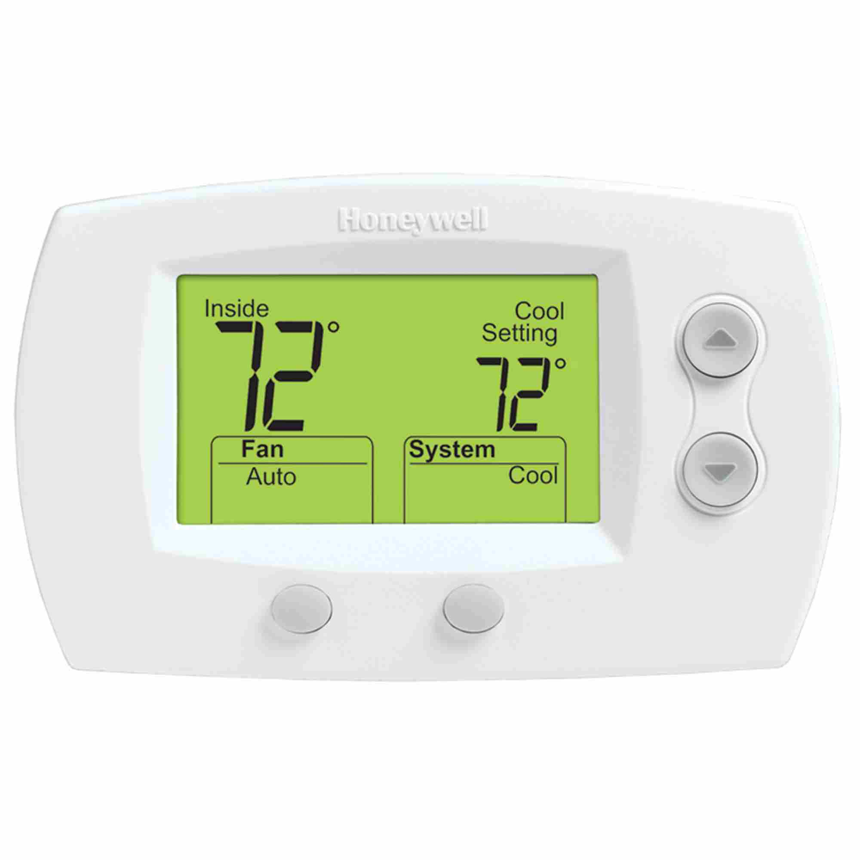
Power (24VAC)
Compressor
Aux / Emer Heat
Compressor
Fan
Reverse (Heat/Cool)
Reverse (Heat/Cool)

